Slide 1

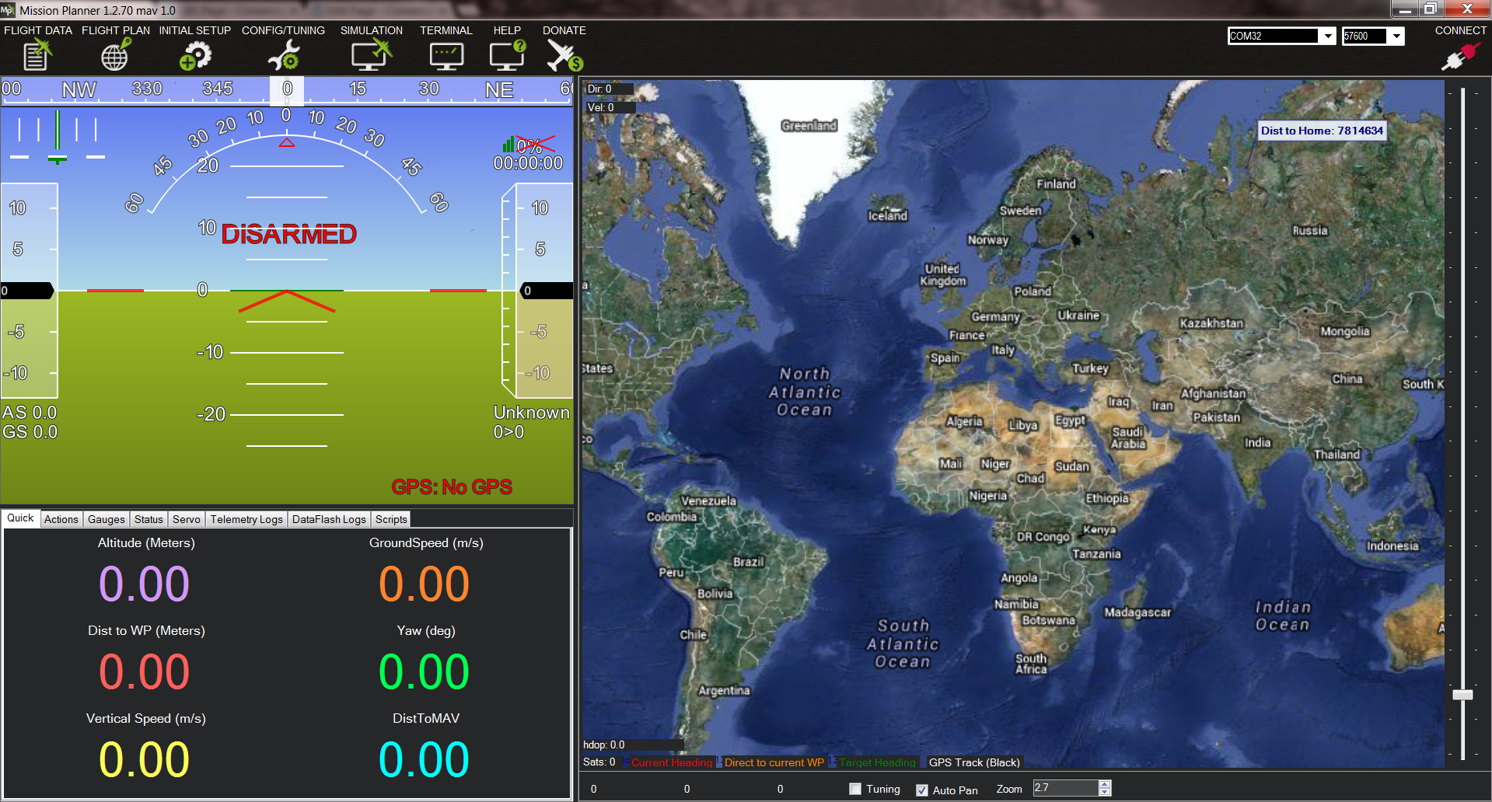

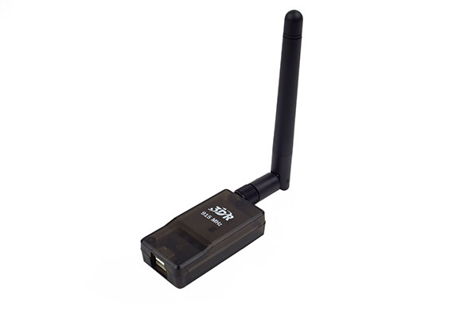
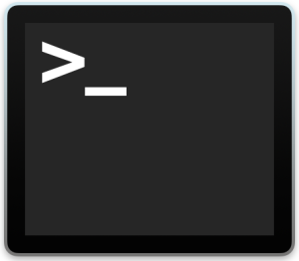

GCS
OUT
(UDP)
MASTER
(COM)
MAVPROXY
Mavproxy arguments:
--master=com7 (for radio telemetry) OR
--master=tcp:127.0.0.1:5760 (for simulated)
--out=upd:IP_Address:14550
--out=upd:IP_Address:14551
OUT
(UDP)
Py Script

